Slide 1
Anomaly Detection

Slide 2
Agenda
What are anomalies/outliers?
What is anomaly detection?
Types of Data
Univariate vs. Multivariate data
Statistical Approaches – outliers detection
Parametric vs. non-Parametric
Non-Parametric Tests
Mahalonobis Distance (Univariate)
Mahalanobis Taguchi system (Multivariate)
Parametric Tests
Hotelling's T-squared (Multivariate)

Slide 3
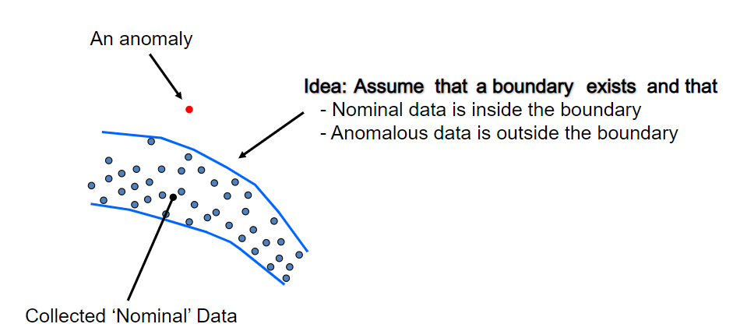
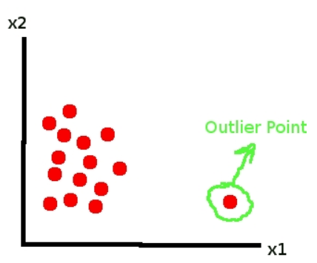
Anomalies/Outliers
What is anomaly or outlier?
Set of data points or observations which deviate from rest of the data

Slide 4
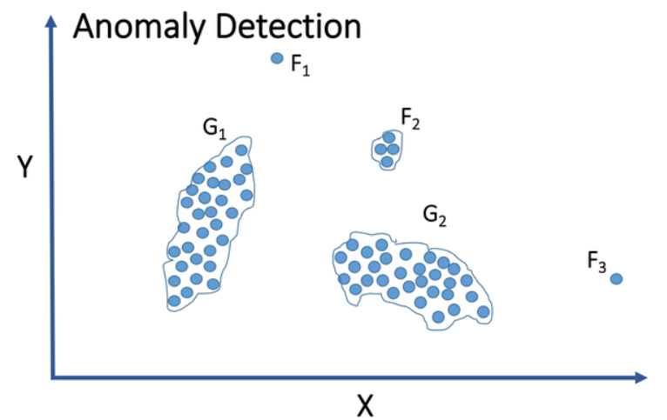
Anomaly Detection
Anomaly detection is the process of identifying data points, events, and/or observations that deviate from the dataset's normal behavioral patterns.

Slide 5
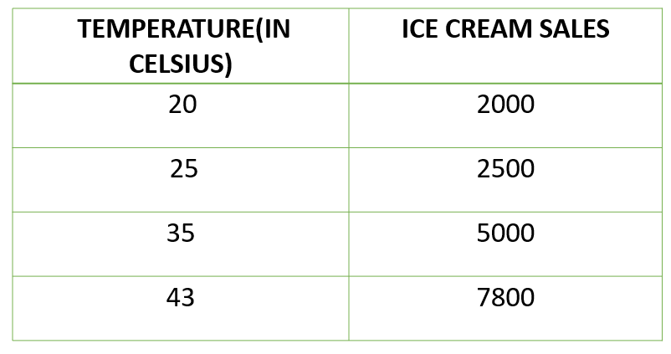
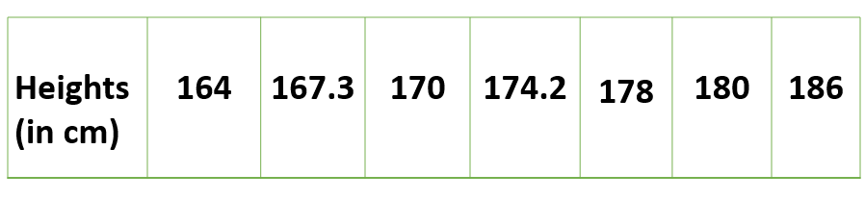
Data Types
Types of Data Variables
Univariate
The data being analyzed contains only one variable.
Multivariate
The data being analyzed contains more than one predictor variable. It tries to establish relationship using more than one predictor on some response.

Slide 6
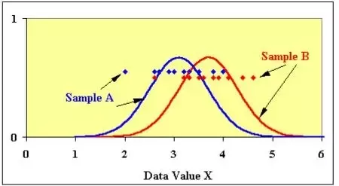
Statistical Approaches – Outlier detection
Parametric tests assume underlying statistical distributions in the data. Therefore, several conditions of validity(assumptions) must be met in order for the test to be reliable.
Nonparametric tests do not rely on any distribution. They can thus be applied even if parametric conditions of validity are not met.

Slide 7
Non-Parametric Tests
Using Univariate and Multivariate Data

Slide 8
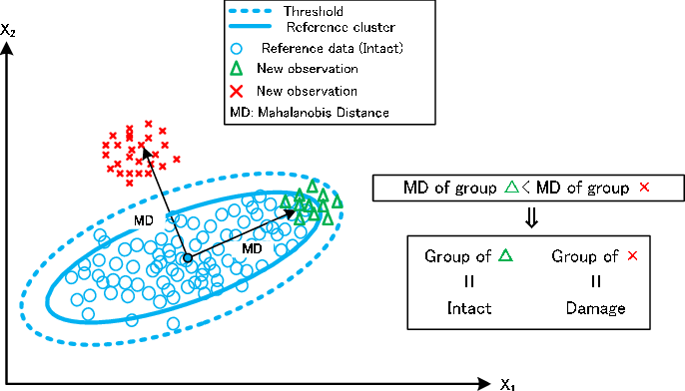
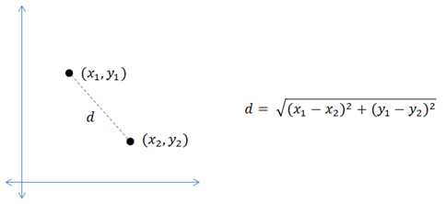
Nonparametric Test - Multivariate
Mahalonobis Distance
Mahalanobis distance - Multivariate distance metric to detect outliers by measuring the distance between a point (P) and a distribution (D) with respect to correlation.
Euclidean distance - Refers to the distance between two points.

Slide 9
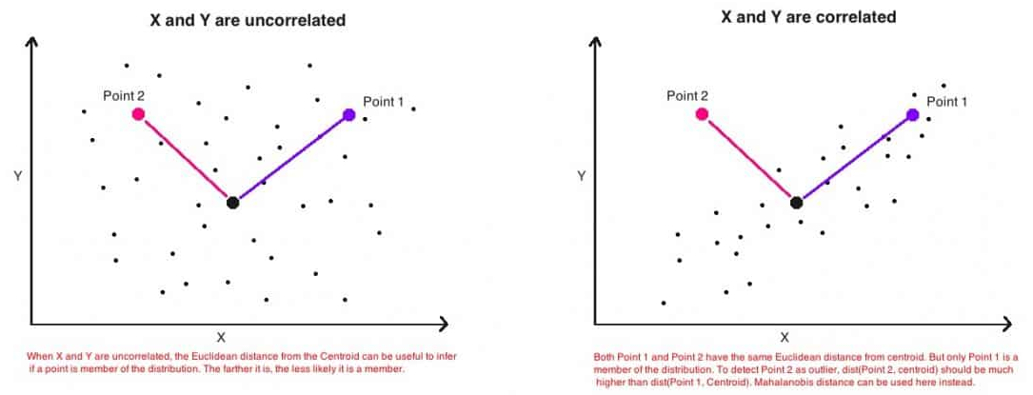
Nonparametric Test - Multivariate
Issue with Euclidean Distance for Multivariate data
If the dimensions (attributes) are correlated, the Euclidean distance between a point and the center of the points (distribution) can give little or misleading information about how close a point really is to the cluster.
Notes:
The above image (on the right) is a simple scatterplot of two variables that are positively correlated with each other. That is, as the value of one variable (x-axis) increases, so does the value of the other variable (y-axis).
The two points above are equally distant (Euclidean) from the center. But only one of them (blue) is actually more close to the cluster, even though, technically the Euclidean distance between the two points are equal.
This is because, Euclidean distance is a distance between two points only. It does not consider how the rest of the points in the dataset vary. So, it cannot be used to really judge how close a point actually is to a distribution of points.
What we need here is a more robust distance metric that is an accurate representation of how distant a point is from a distribution.

Slide 10
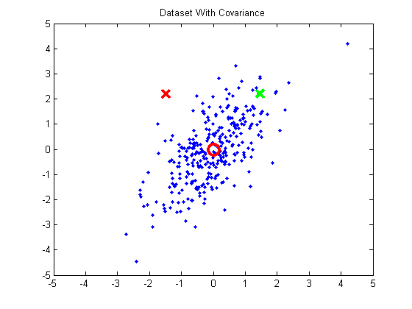
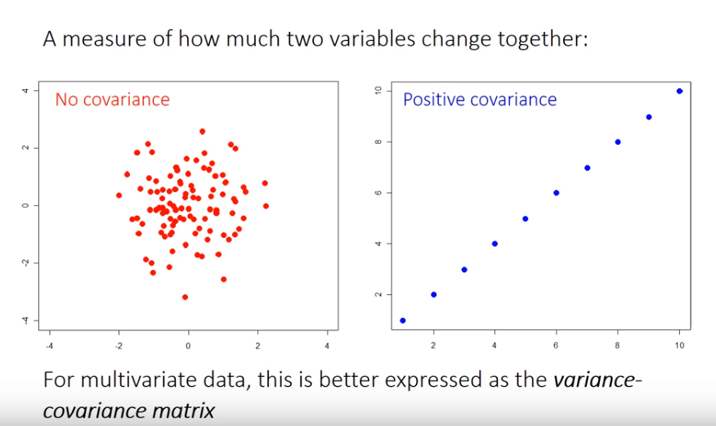
Nonparametric Test - Multivariate
Mahalanobis Distance
The Mahalanobis distance has the following properties:
It accounts for the fact that the variances in each direction are different.
It accounts for the covariance between variables.
It reduces to the familiar Euclidean distance for uncorrelated variables with unit variance.
Note: “covariance” and “correlation” are similar concepts; the correlation between two variables is equal to their covariance divided by their variances.

Slide 11
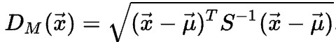
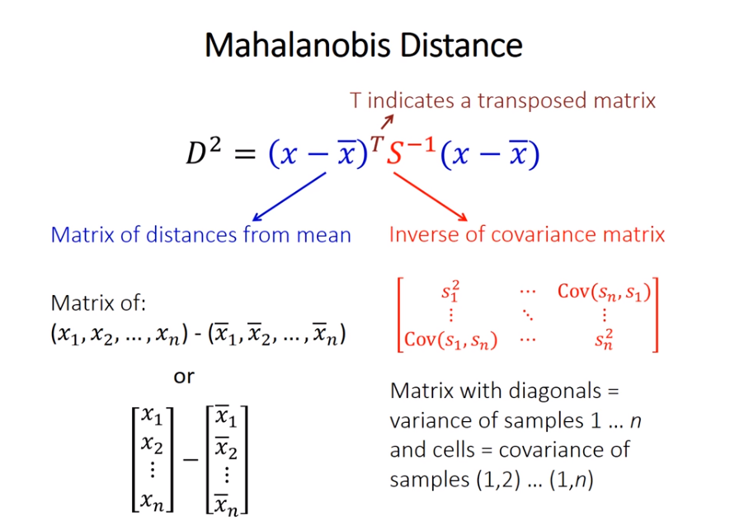
Nonparametric Test - Multivariate
How to Calculate Mahalanobis Distance
The Mahalanobis distance is calculated using equation

Slide 12
Nonparametric Test - Multivariate
Mahalanobis Distance –
Implementation using Python (see the notebook)

Slide 13
Nonparametric Test - Multivariate
Mahalanobis-Taguchi System (MTS)
It is an effective non-parametric forecasting and variable reduction method for multivariate data
It follows methodology of robust design in which
parameters of a product are optimized for their optimum values using statistical experimentation
It classifies data into normal and abnormal groups
Taguchi’s orthogonal arrays dictate the total number of experiments required to be run
Each experiment calculates average signal-to-noise ratio of each variable or feature and thus helps in carrying out variable elimination

Slide 14
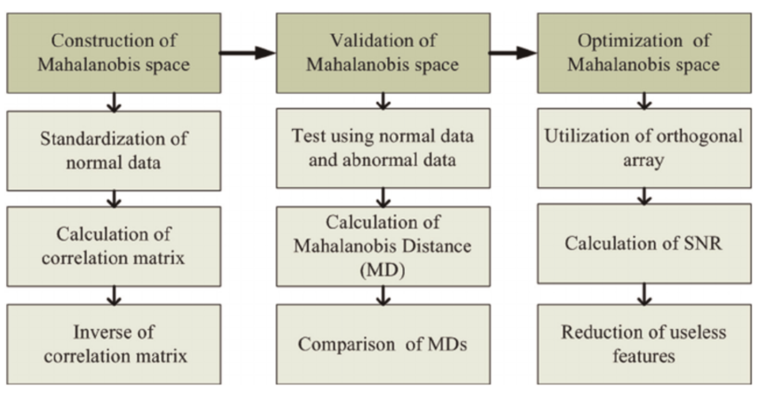
Nonparametric Test - Multivariate
Mahalanobis-Taguchi System (MTS)
The flow chart defines the process for MTS

Slide 15
Nonparametric Test - Multivariate
Mahalanobis-Taguchi System (MTS)
Implementation using Python
DATASET SPECS:
Normal Records aka “Non events”: 131 Rows 239 columns
Abnormal Records aka “Events” : 577 Rows 239 columns
STEP 1 : Normalize both “events” and “non-events”.
STEP 2 : Calculate the correlation matrix for events. Compute the inverse.
STEP 3 : Compute reference group mahalanobis distance using “Normal” records and correlation matrix calculated in Step 1.
STEP 4 : Compute abnormal set mahalanobis distance using “Abnormal” records and correlation matrix calculated in Step 1.
STEP 5: COMPARE
STEP 6: Use Taguci orthogonal array of 256 experiments and 255 variables( as we have 239 columns).
STEP 7: Generate experiments. 577 distance values and 256 experiments give a 577 x 256 matrix.
STEP 8: Compute Signal to Noise ratio.
STEP 9 : Compute two separate matrices, one for used columns and one for un-used columns.
Step 10: For each column, compute the difference between the SN ratio of the used column matrix and un-used column matrix.
Step 11: Sort in descending order to eliminate useless features.

Slide 16
Parametric Tests
Using Multivariate Data

Slide 17
Parametric Test - Multivariate
Hotelling’s T-squared
Hotelling’s T² is the multivariate parametric approach to finding anomalies
It is a multivariate counter part to the t-test
For ease of calculation, Hoteling T² is usually transformed into an F-statistic with a scaling factor.

Slide 18
Parametric Test - Multivariate
Hotelling’s T-squared
In Hotelling’s T² the null hypothesis H_{o} is that the group means for all response variables are equal.
Since it is a Parametric approach, Hotelling T² makes following assumptions
Each population follows the multivariate normal distribution.
The two samples are independent.
The two covariance matrices are equal.
A significant test result means some combination of variables differ significantly between samples.

Slide 19

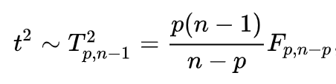

Parametric Test - Multivariate
How Hotelling’s T-squared is calculated?
It is based on Mahalanobis Distance between two sample(n) means.
As a subsequent step, F-distribution transformation is applied, like so
Where is the F-distribution with parameters p and n-p. A p-value is calculated from an F-distribution table.

Slide 20
Parametric Test - Multivariate
Hotelling’s T-squared –
Implementation using Python (given in the notebook)

Slide 21
References
http://www.erogol.com/anomaly-detection-and-a-simple-algorithm-with-probabilistic-approach/
https://www.quora.com/Can-reinforcement-learning-be-used-for-anomaly-detection
https://medium.com/@alhadpofali_5697/anomaly-and-outlier-detection-concepts-1f82498851a2
https://medium.com/@mehulved1503/outlier-detection-and-anomaly-detection-with-machine-learning-caa96b34b7f6
https://en.wikipedia.org/wiki/Interquartile_range
http://sphweb.bumc.bu.edu/otlt/mph-modules/bs/bs704_summarizingdata/bs704_summarizingdata7.html
http://makemeanalyst.com/explore-your-data-range-interquartile-range-and-box-plot/
https://dzone.com/articles/four-techniques-for-outlier-detection-knime
https://towardsdatascience.com/a-brief-overview-of-outlier-detection-techniques-1e0b2c19e561
https://dzone.com/articles/spotting-outliers-with-isolation-forest-using-skle
https://www.analyticsvidhya.com/blog/2019/02/outlier-detection-python-pyod/
https://quantdare.com/isolation-forest-algorithm/
https://medium.com/walmartlabs/swamping-and-masking-in-anomaly-detection-how-subsampling-in-isolation-forests-helps-mitigate-bb192a8f8dd5
https://www.youtube.com/watch?v=RyFQXQf4w4w (Isolation Tree)
https://dzone.com/articles/spotting-outliers-with-isolation-forest-using-skle
https://towardsdatascience.com/anomaly-detection-for-dummies-15f148e559c1
https://towardsdatascience.com/anomaly-detection-with-isolation-forest-visualization-23cd75c281e2

Slide 22
References
https://www.machinelearningplus.com/statistics/mahalanobis-distance/
https://mccormickml.com/2013/08/15/the-gaussian-kernel/
https://en.wikipedia.org/wiki/Mahalanobis_distance
https://www.statisticshowto.datasciencecentral.com/mahalanobis-distance/
https://mccormickml.com/2014/07/22/mahalanobis-distance/
https://onlinelibrary.wiley.com/doi/full/10.1002/cem.2763
https://www.youtube.com/watch?v=ch97ZqH0XdM
https://ncss-wpengine.netdna-ssl.com/wp-content/themes/ncss/pdf/Procedures/NCSS/Hotellings_Two-Sample_T2.pdf
https://www.statisticshowto.datasciencecentral.com/hotellings-t-squared/
https://en.wikipedia.org/wiki/Hotelling%27s_T-squared_distribution
https://www.youtube.com/watch?v=ch97ZqH0XdM
https://www.tandfonline.com/doi/abs/10.1198/004017002188618626

